Slide 1
Mental Illness Service Availability and It’s Affect on Crime Rate in NYC Boroughs
Group 3: Zac Blankenship, La’Berrick Williams, Zachary Creamer, Fran

Slide 2
Outline
Group 3 used a 6 step-phased approach with our Data Analysis:
ASK- Develop Questions for Data Analysis
PREPARE - Collecting and Preparing the Data
PROCESS - Clean the Data for various inaccuracies, errors, and inconsistencies
ANALYZE - Identify any relationships, trends, and patterns that assist with solving the business problem more accurately
SHARE - Presenting the Data findings
ACT - Present Lessons Learning and Recommendations on how to solve the problem and make good business decisions

Slide 3
Ask
Our team identified our Business Case for analysis regarding Mental illness service availability and its effect on crime rate in NYC Boroughs
3 Questions were developed from our Business Case:
What is the crime rate for each of NYC’s boroughs? Is the crime rate higher in certain boroughs?
Are certain crimes higher in certain areas? How does that correlate with available services?
Does the number of mental health facilities affect the crime rates?

Slide 4
Prepare
3 .cvs files were originally identified for our Business Case:
Original Files
NYS-Mental-Facilities.csv (4,958 rows of data)
NYPD_Arrest_Data_2023.csv (170,096 rows of data)
Nyc_zip_borough_neighborhoods.csv (178 rows of data)
Merged Files
Menta_Fac_Boroughs (79 rows of data)
NYC_Bor_Arrest (1,020,576 rows of data)
Team members identified separate data files for deep dive activities

Slide 5



Process
Unnecessary columns, duplicate rows, and empty fields were removed from the data sets
NYC Mental Health Facilities
NYPD Arrest Data 2023
NYC Zip, Boroughs, Neighborhoods

Slide 6
Analyze (1 of 5)
Our team used a series of visual graphics to bring meaning to our data
We used our 2 of 3 questions to assist with our Analyze Phase
What is the crime rate for each of NYC’s boroughs? Is the crime rate higher in certain boroughs?
Are certain crimes higher in certain areas? How does that correlate with available services?
Hypothesis: If there is a relationship between the number of mental health facilities in NYC boroughs and their respective crime rates, then the boroughs with the most mental health facilities should have lower crime rates

Slide 7


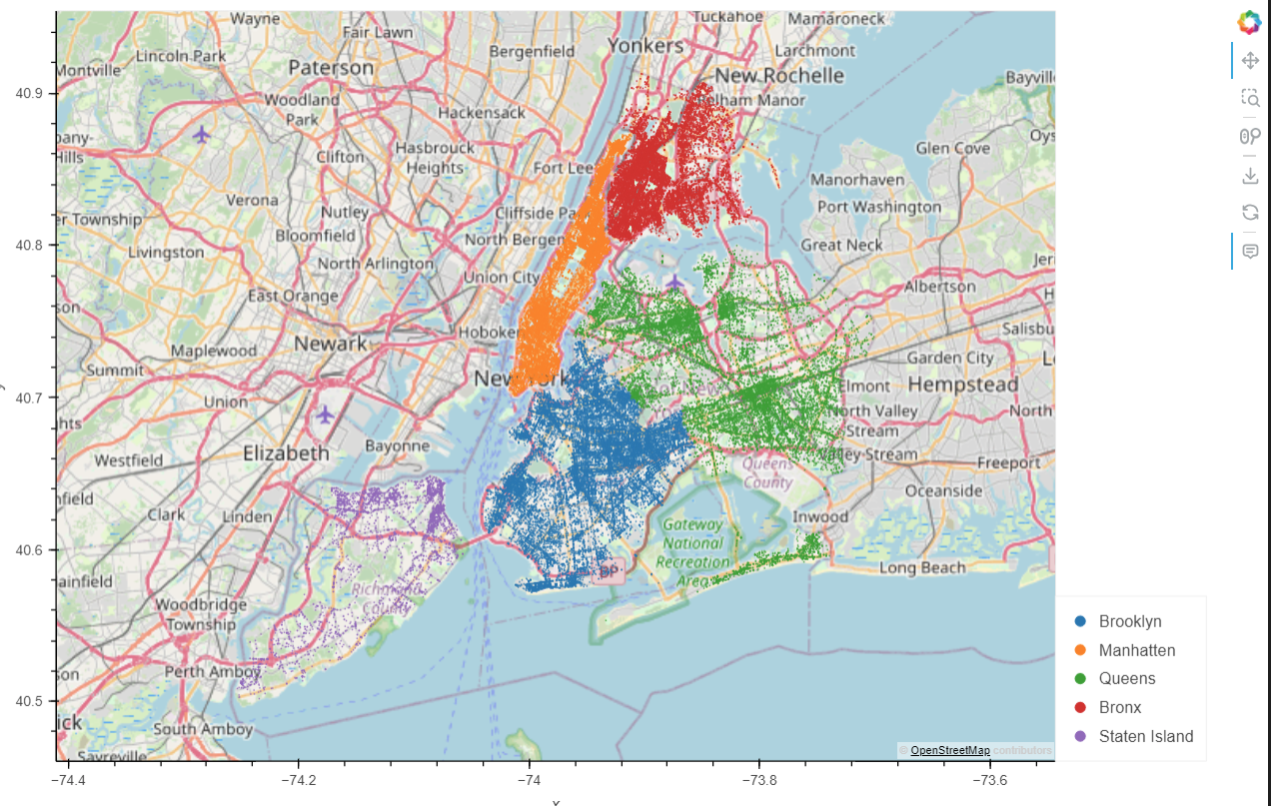

Analyze (2 of 5)
Question 1: What is the crime rate for each of NYC’s boroughs? Is the crime rate higher in certain boroughs?
Geoviews graphics were used to identify the number of arrests in each borough

Slide 8
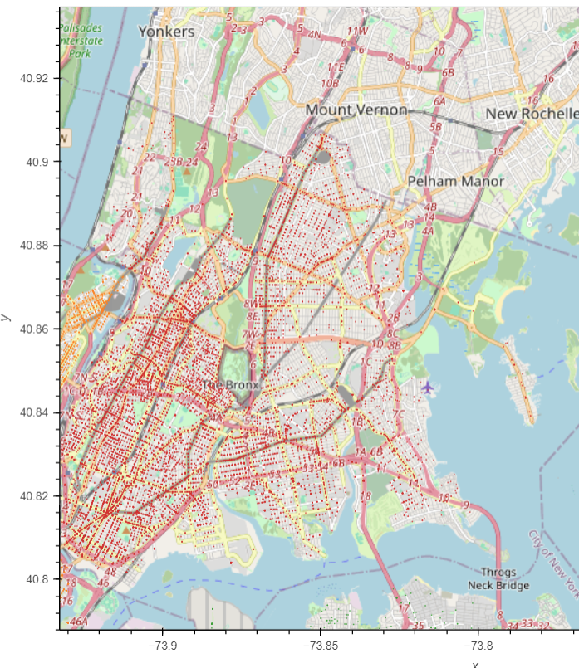
Analyze (2 of 5) a.
Bronx Arrest Data
9 Mental Health Facilities
1,472,654 Population

Slide 9
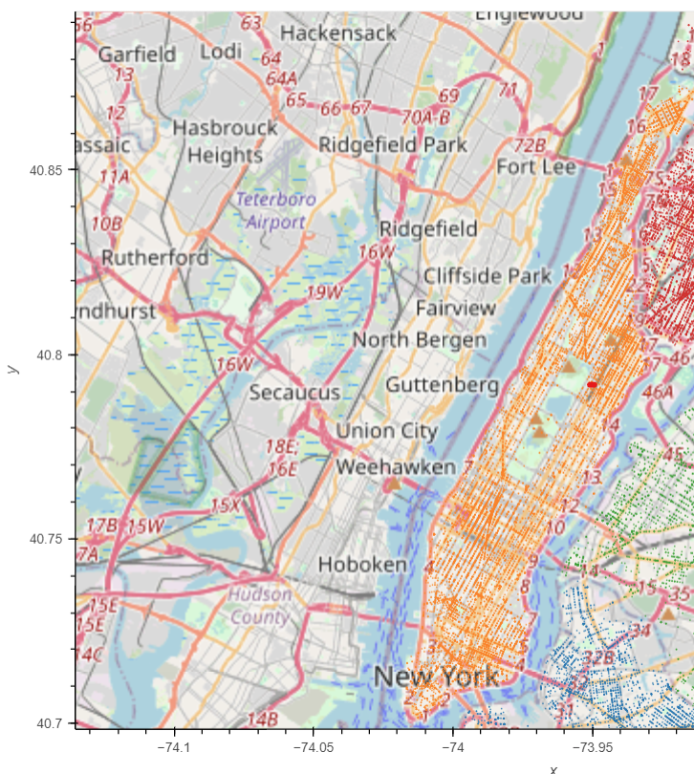
Analyze (2 of 5) b.
Manhattan Arrest Data
33 Mental Facilities
1,694,251 Population

Slide 10
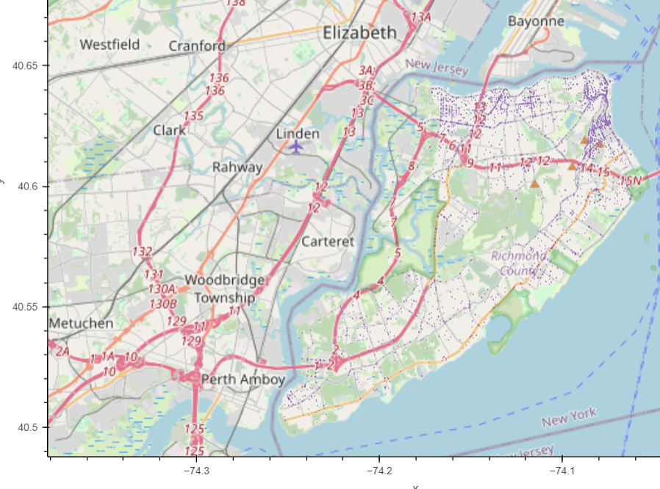
Analyze (2 of 5) c.
Staten Island Arrest Data
3 Mental Facilities
495,747 Population

Slide 11
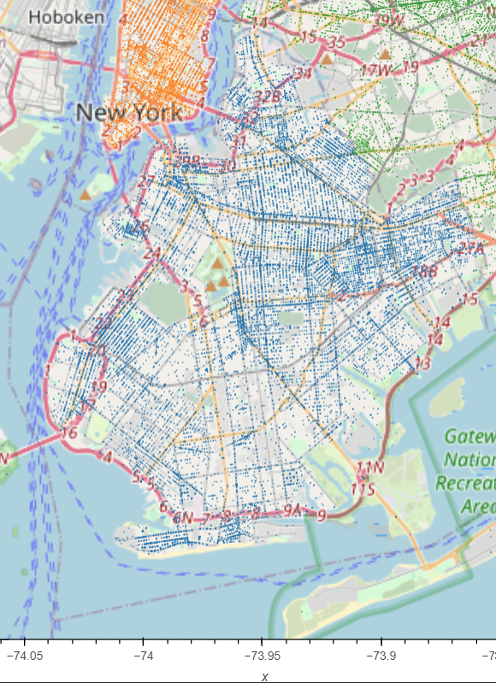
Analyze (2 of 5) d.
Brooklyn Arrest Data
19 Mental Facilities
2,736,074 Population

Slide 12
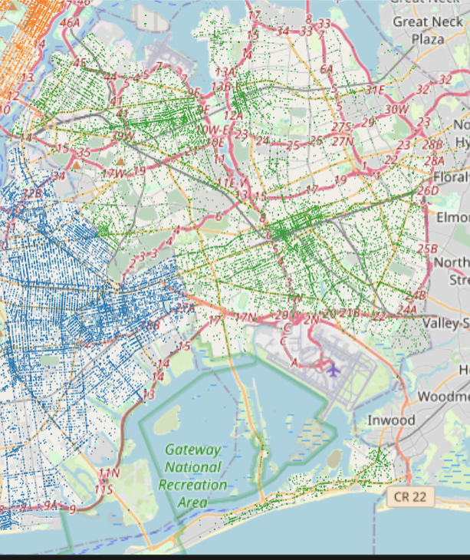
Analyze (2 of 5) e.
Queens Arrest Data
14 Mental Facilities
2,405,464 Population

Slide 13
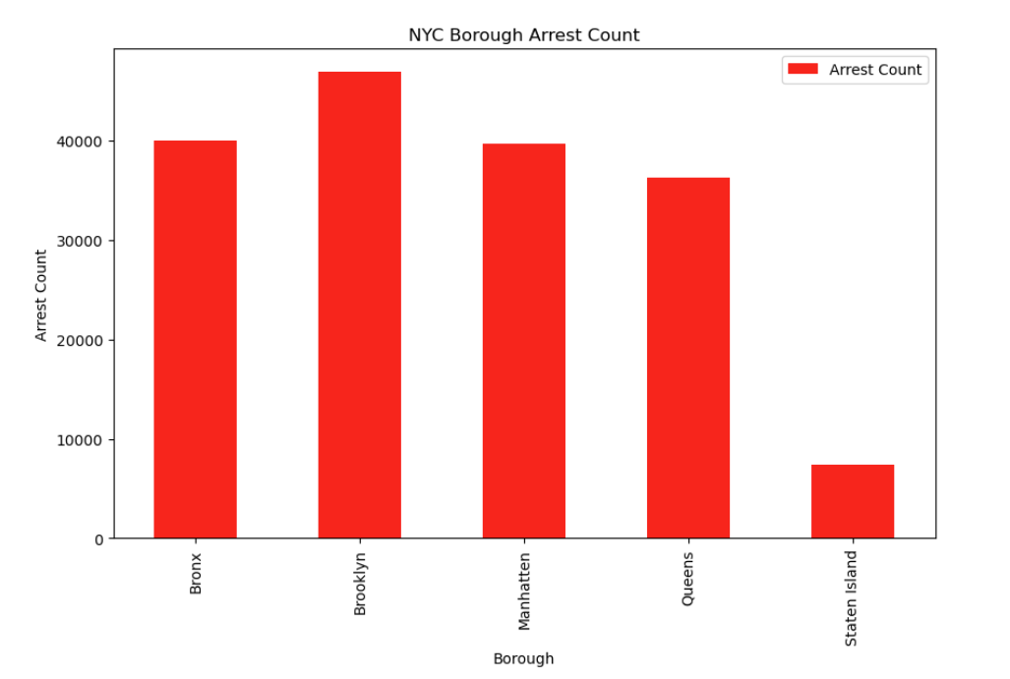
Analyze (3 of 5)
After grouping all of the arrest records by borough and finding the sum for each, we see that Brooklyn, Manhattan, and the Bronx have the highest arrest counts with Staten Island with the lowest.
Based on this data, we can assume that Brooklyn, Manhattan, and the Bronx have the least amount of mental health facilities while Staten Island has the most.

Slide 14
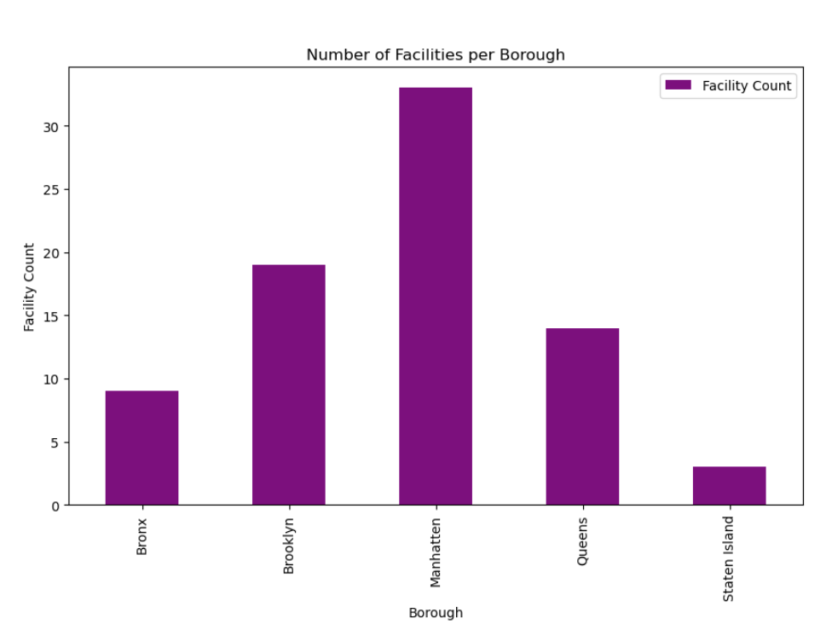
Analyze (4 of 5)
By getting the number of facilities for each borough, we actually find our guess to be incorrect. Manhattan, the borough with the second most arrests actually had the most mental health facilities while Staten Island, the borough with the lowest amount of arrests, had the least amount of mental health facilities.
After reviewing this new data, it begins to make sense why our assumption was wrong. The city is more likely to provide more mental health facilities in areas where they see the most amount of crime.

Slide 15
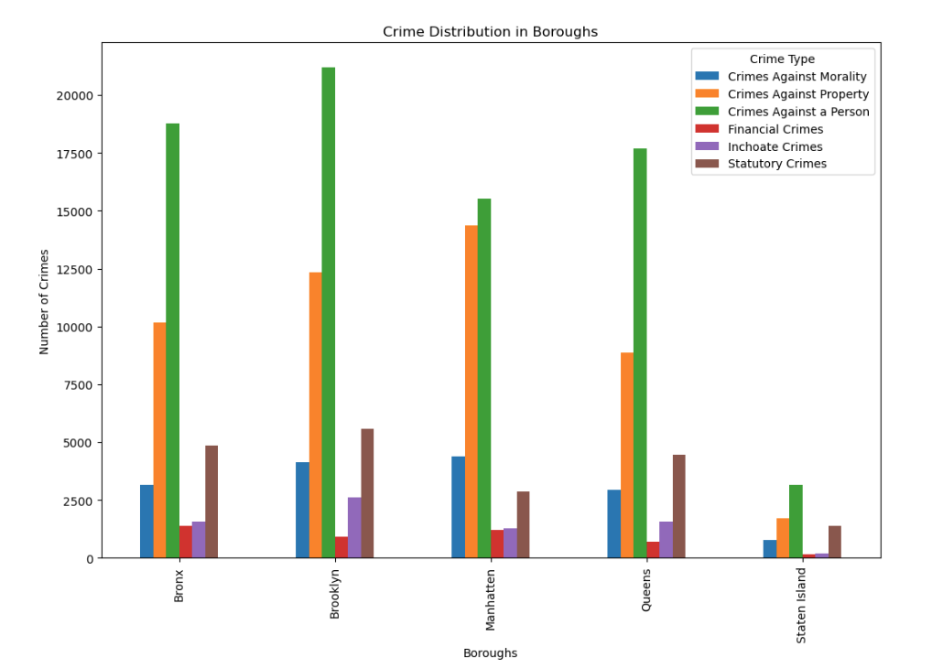
Analyze (5 of 5)
Question 2: Are certain crimes higher in certain areas? How does that correlate with available services?
We categorized each criminal offense into one of six categories and then got the sum for each category within a borough.
As you can see by the bar chart, there really isn’t much difference between the boroughs in terms of which type of crime is higher. Crimes against a person (robbery, murder, assault, etc) is the highest category in each borough followed by crimes against a property (vandalism, burglary, arson, etc) and statutory crimes (public intoxication, drug possession, etc).

Slide 16
Share (1 of 4)
Statistical Analysis was executed to determine if our hypothesis is accepted or rejected
We answered our third question in the Share Phase

Slide 17
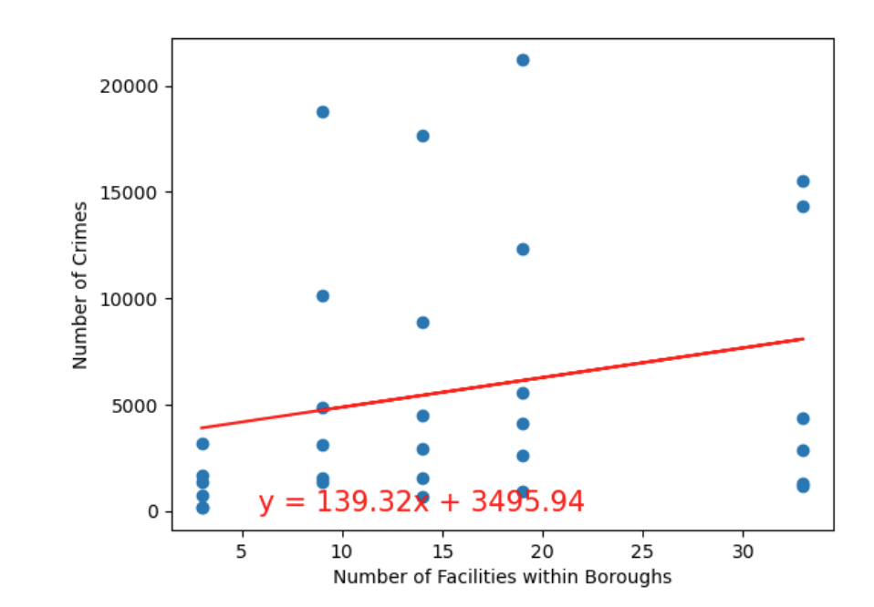
Share 2 of 4
The r-squared is: 0.05473956549922081
So how does amount of arrests correlate with number of facilities within the boroughs?
Based on the r-squared value, we can conclude that the linear relationship between arrests and number of facilities is weak. However, there still might be some association, it’s just not well-captured by our linear model.
As our chi-squared test proves, there is a relationship between crimes and number of mental health facilities.

Slide 18
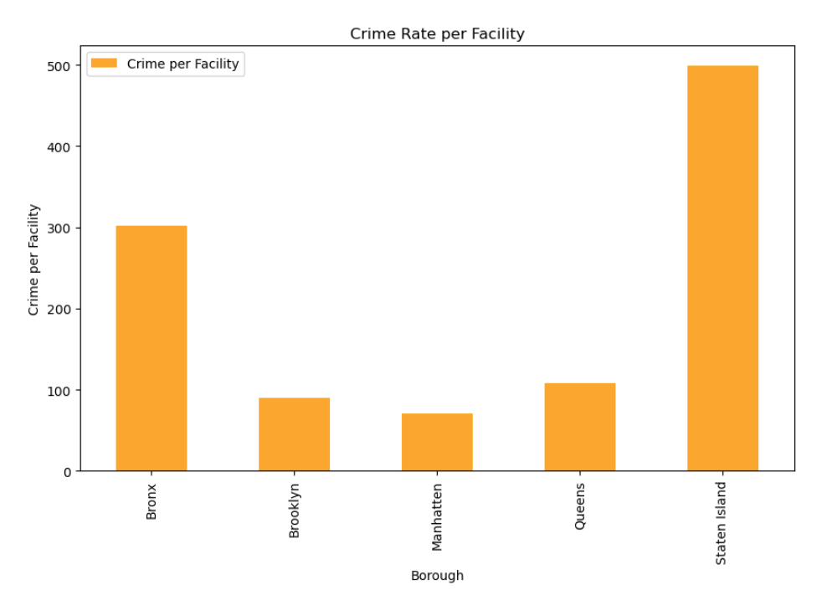
Share 3 of 4
Question 3: Does the number of mental health facilities affect the crime rates?
Our analysis of crime rate per borough facility does reveal a correlation between lower and mental health facilities across the different NYC boroughs.
Areas with fewer mental health facilities tend to experience increased crime rates, which highlights a potential connection between mental health resources and community safety.

Slide 19
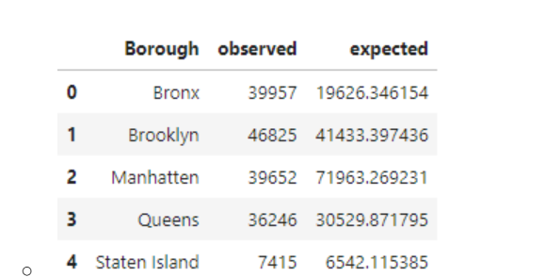
Share (4 of 4)
Chi Squared Test
Hypothesis: If there is a relationship between mental health facilities in NYC boroughs and their respective crime rates, then the number of mental health facilities withing NYC boroughs should have an impact on crime rates.
Null Hypothesis: There is no significant relationship between the number of mental health facilities and crime in NYC boroughs.
Critical value = 9.487729036781154
Power_divergenceResult(statistic=37456.18135041619, pvalue=0.0)
The statistic is significantly higher than our critical value and the p-value is very close to zero so we will be rejecting our null hypothesis.
These results suggest that there is a significant association between arrest counts and number of facilities.

Slide 20
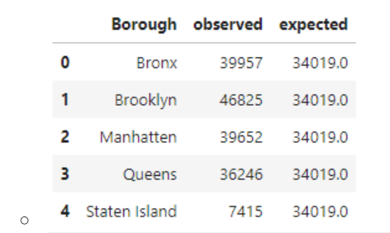
Share (4 of 4) cont.
Chi Squared Test
Out of curiosity, we ran the chi-squared test with the expected value evenly distributed across all boroughs just to see if there was any significant change.
Critical value = 9.487729036781154
Power_divergenceResult(statistic=27740.865810282492, pvalue=0.0)
This second test had similar results and re-confirmed our hypothesis

Slide 21
Act
Several Assumptions and Observations were drawn from our Analysis
Mental Facilities number could be considered based off of size of borough
Mental Facilities could be based off of the income level of the zip codes within a borough
Mental Facility Data did not have latitude and longitude values to compare geoviews with arrest data to determine a more accurate impact.

